Slide 1
Submuestreo
Pablo Irarrazaval

Slide 2
Necesitamos velocidad
Submuestreo

Slide 3
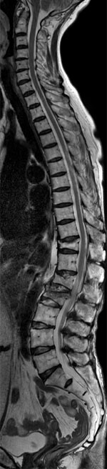
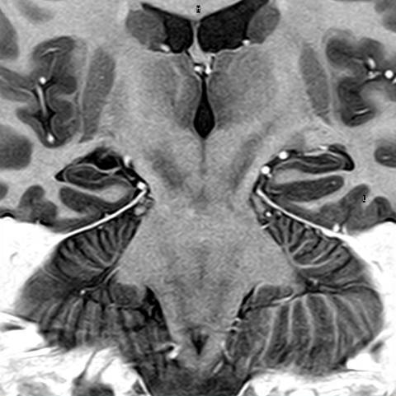
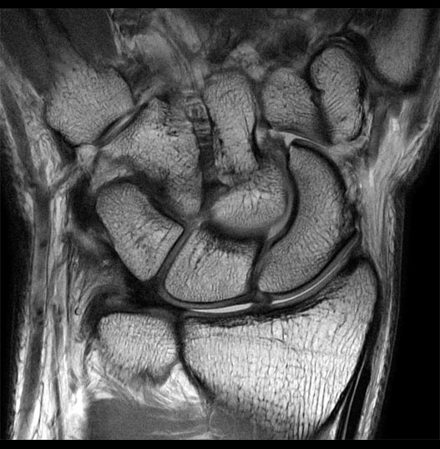
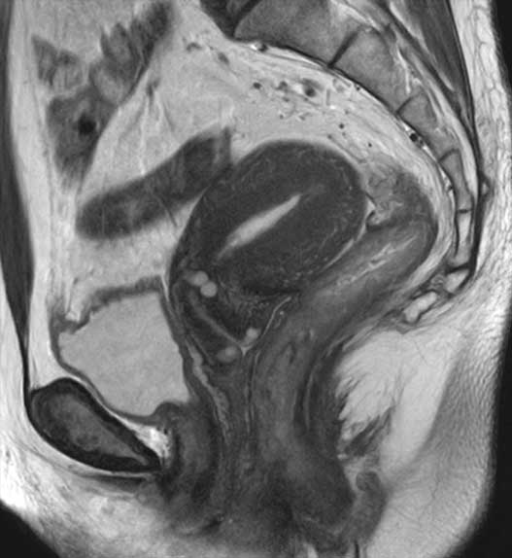
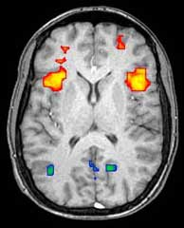
MRI is great
BUT …

Slide 4
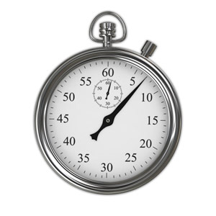

MRI is great
BUT …
BUT …

Slide 5
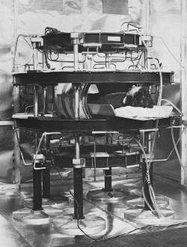
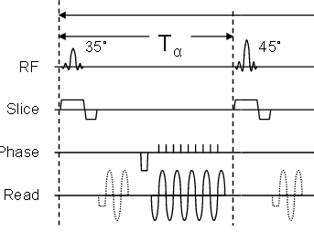
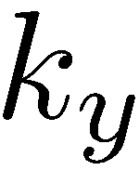
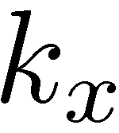
Need for speed
Three approaches for faster MRI:
Better hardware
Clever sequences
or trajectories
Under-sampling

Slide 6
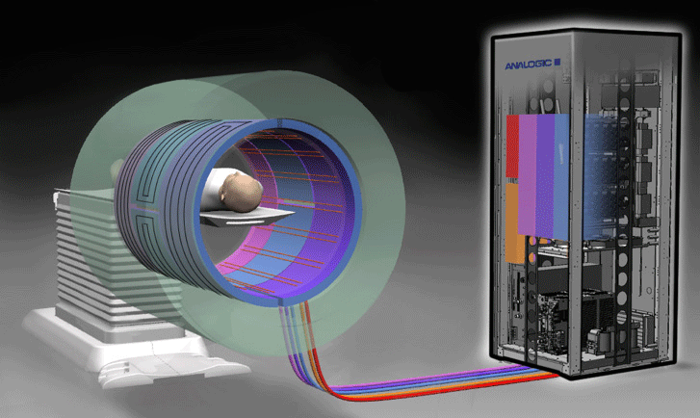
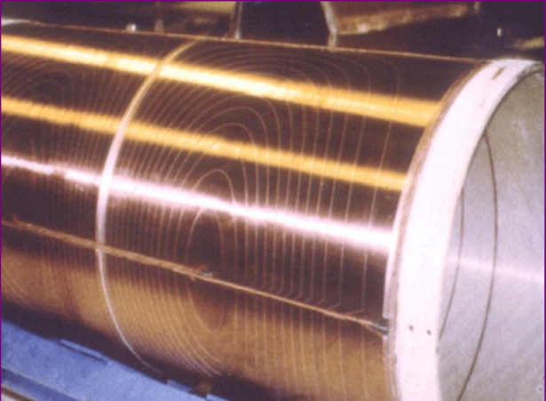
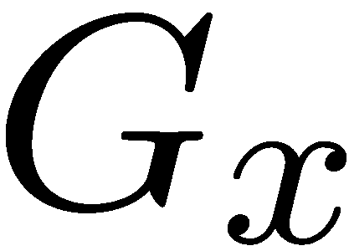
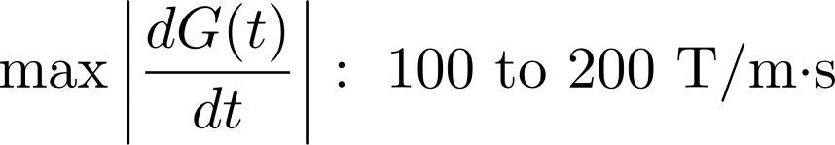

Gradient systems
“Wasted time”
Limits from amplifiers and nerve stimulation

Slide 7
There are several k-space trajectories
Single slice | 2DFT | EPI | Radial
Tad (ms) | 1 | 32 | 1
N | 256 | 8 | 402
TR (ms) | 10 | 60 | 10
Acq Time (s) | 2.56 | 0.48 | 4.02

Slide 8
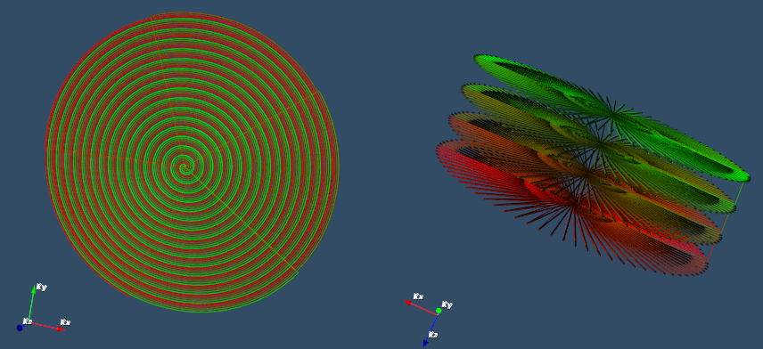
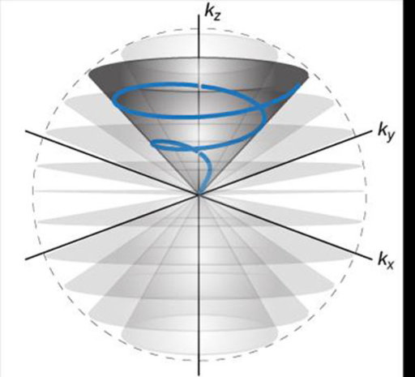
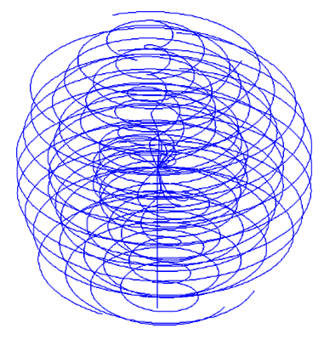
There are several k-space trajectories

Slide 9
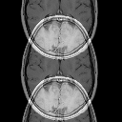
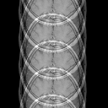
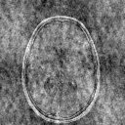
Undersampling
Skipping data points
2x Uniform
4x Uniform
4x Random

Slide 10
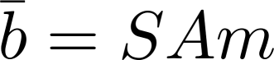
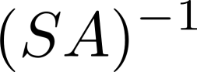

Image Reconstruction
Acquired data (n under-sampled)
N unknowns and n equations
Reconstruction
does not exist infinite solutions
What can we do?

